Slide 1
Interface in Java

Slide 2
An interface in java is a blueprint of a class. It has static constants and abstract methods.
The interface in Java is a mechanism to achieve abstraction. There can be only abstract methods in the Java interface, not method body. It is used to achieve abstraction and multiple inheritance in Java.
In other words, you can say that interfaces can have abstract methods and variables. It cannot have a method body.
Java Interface also represents the IS-A relationship.
It cannot be instantiated just like the abstract class.

Slide 3
Why use Java interface?
There are mainly three reasons to use interface. They are given below.
It is used to achieve abstraction.
By interface, we can support the functionality of multiple inheritance.
It can be used to achieve loose coupling.

Slide 4
How to declare an interface?
An interface is declared by using the interface keyword. It provides total abstraction; means all the methods in an interface are declared with the empty body, and all the fields are public, static and final by default. A class that implements an interface must implement all the methods declared in the interface.
Syntax:
interface <interface_name>{
// declare constant fields
// declare methods that abstract
// by default.
}
The Java compiler adds public and abstract keywords before the interface method. Moreover, it adds public, static and final keywords before data members.

Slide 5
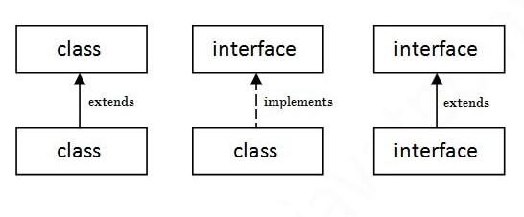
The relationship between classes and interfaces
As shown in the figure given below, a class extends another class, an interface extends another interface, but a class implements an interface.

Slide 6
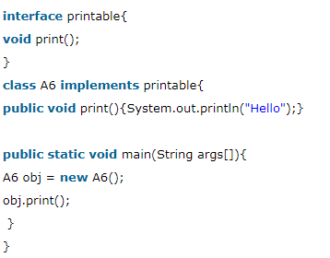
Java Interface Example
In this example, the Printable interface has only one method, and its implementation is provided in the A6 class.

Slide 7
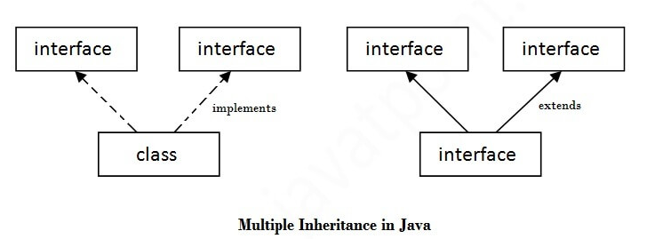
Multiple inheritance in Java by interface
If a class implements multiple interfaces, or an interface extends multiple interfaces, it is known as multiple inheritance.

Slide 8
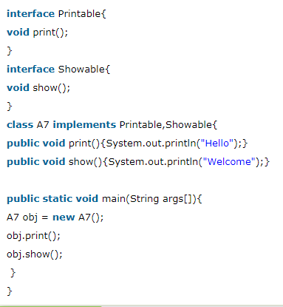

Slide 9
multiple inheritance is not supported in the case of class because of ambiguity. However, it is supported in case of an interface because there is no ambiguity. It is because its implementation is provided by the implementation class.

Slide 10
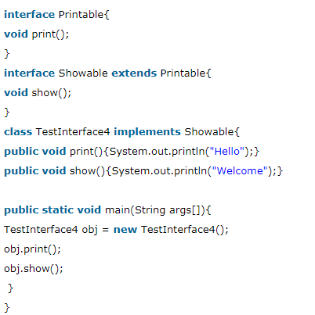
Interface inheritance
A class implements an interface, but one interface extends another interface.

Slide 11
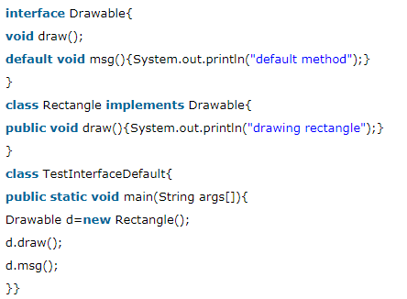
Default Method in Interface
We can have method body in interface. But we need to make it default method.

Slide 12
Difference between abstract class and interface
Abstract class and interface both are used to achieve abstraction where we can declare the abstract methods. Abstract class and interface both can't be instantiated.

Slide 13
